Slide 1
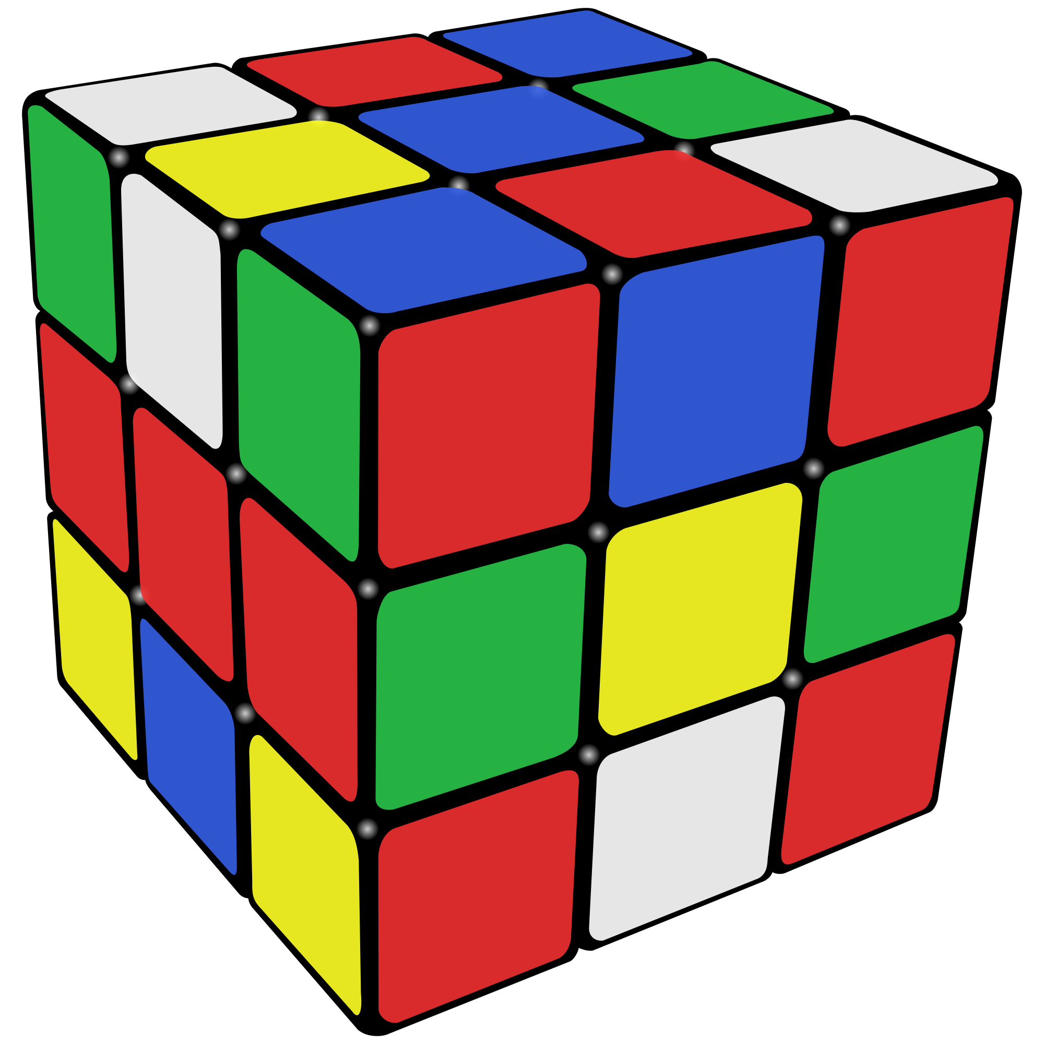
Rubix Cube Solver
Presented By:
Rasikh-ur-Rehman Natiq

Slide 2
Overview:
Camera first reads the faces of the real rubik’s cube.
Then passes the states to the function to search that state on a specific level in the dataset. It then shows the move sequence to solve the Rubik’s cube.

Slide 3
Procedure:
Data Input
Use Of Camera
Adjustment Of Rubik’s Cube

Slide 4
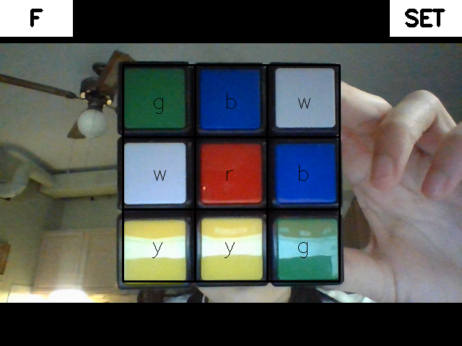
View Initial State:
When all six faces are recorded, a rubik's cube in the recorded face should be displayed. Confirm that the state is correct and close the window.

Slide 5
Solve:
Program will solve the rubik’s cube, then the list of steps will be shown to user for solving rubik's cube.

Slide 6
Code

Slide 7
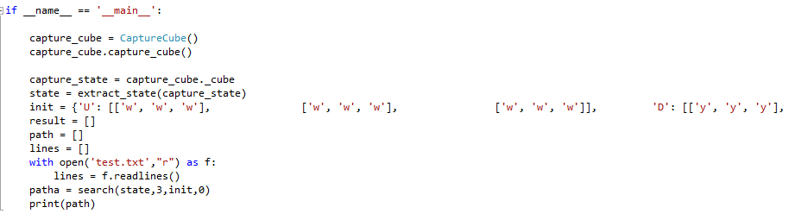

Slide 8
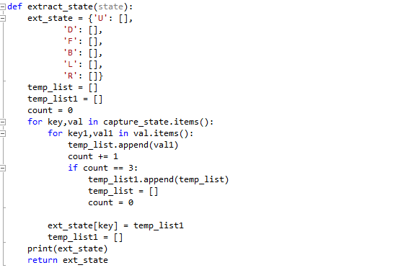

Slide 9
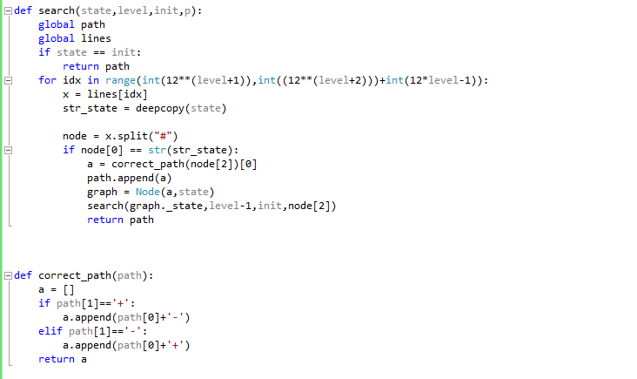

Slide 10
Other Solutions:
Best way to solve this is reinforcement learning.
By using Trees(It's very time consuming. For 4 moves, to run the program we need 150 hours).

Slide 11


